Slide 1
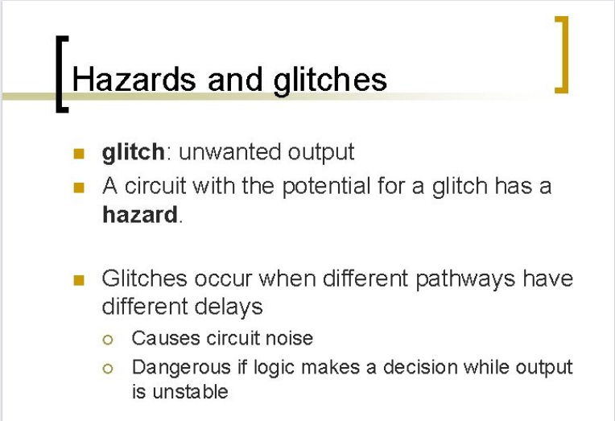
In Digital electronics, a hazard is a glitch waiting to happen. For example, static and dynamic hazards in digital logic.
A hazard is a possibility, while a glitch is the event.
A glitch is an undesirable output, which might be for a short duration.
Invalid and unpredictable output that can be read by the next stage.
Occurs due to propagation delay in digitals circuit.
Correct them after some time.

Slide 2
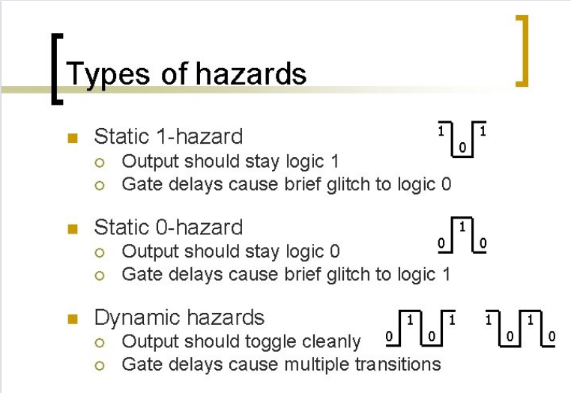

Slide 3
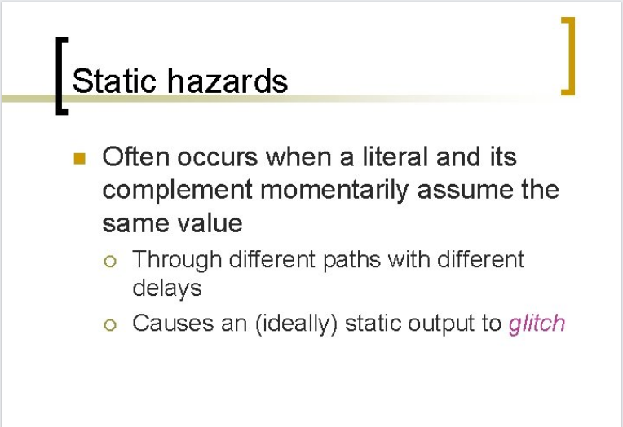

Slide 4
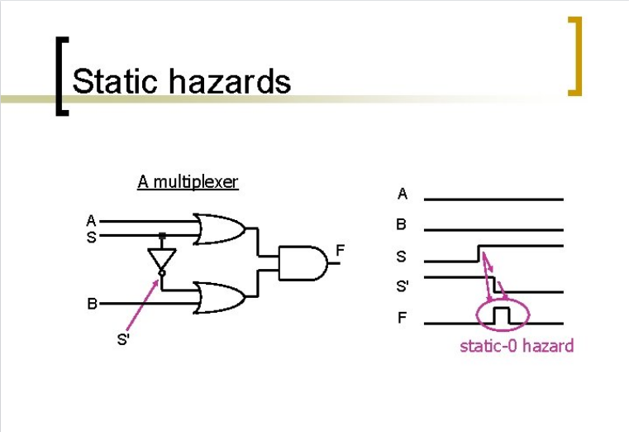

Slide 5
